Slide 1
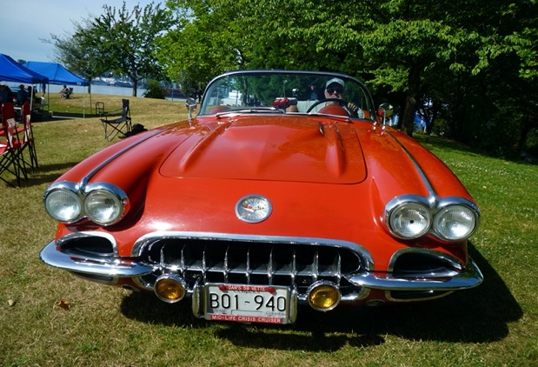
Display vehicles, (Cars, Bikes, Trucks, Tractors, Buses, Boats, Race Cars, anything with an engine) entry $5 – share in thousands of $$ prize pool. Swap meet & market Stalls Live Band “2 Easy” Live Broadcast with Radio Mansfield Van Take – Away food, Breakfast, Morning Tea & Lunch with coffee van Further details: Webpage: www.swanpoolanddistrict.com.au Facebook : swanpool motor festival or contact Ross Coles – 0417351304 swanpoolmotorfestival@gmail.com
Saturday 6th March 2021
Albert Heaney Oval 2426 Midland Highway Swanpool Entry from 8am gold coin donation to local CFA Brigades

